Slide 1
CS 5402 Introduction to Data Mining
Having Enough Data
v.1.0
Perry B. Koob, koobp@mst.edu

Slide 2
What we are going to learn.
Training and Test Sets
Cross-Validation
Leave-one-out
Bootstrap

Slide 3

https://scikit-learn.org/stable/tutorial/machine_learning_map/index.html

Slide 4
If we have enough data...

Slide 5
Training and Test Datasets
...we can partition the data into a Training and Test dataset.
Remember…
We want to make sure we are not over fitting our data.
To do this we make no data point is in both the Training and Test datasets.

Slide 6
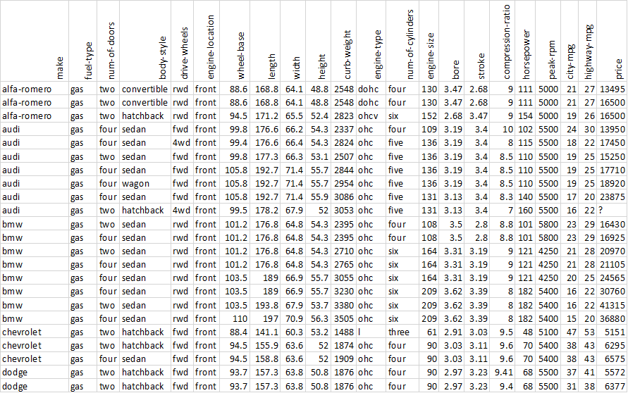
Training and Test
Training Set
Randomly
Selected
Partitioning
Testing Set
205 examples
https://archive.ics.uci.edu/ml/datasets/Automobile

Slide 7
Training and Test
import pandas as pd
import matplotlib.pyplot as plt
from sklearn.model_selection import train_test_split
data = pd.read_csv("..\\src-data\\imports-85.csv")
X = data.drop(columns=['price'])
Y = data[['price']]
X_train, X_test, Y_train, Y_test = train_test_split(X, Y, train_size = 0.80)

Slide 8
Training and Test
import pandas as pd
import matplotlib.pyplot as plt
from sklearn.model_selection import train_test_split
data = pd.read_csv("..\\src-data\\imports-85.csv")
X = data.drop(columns=['price'])
Y = data[['price']]
X_train, X_test, Y_train, Y_test = train_test_split(X, Y, train_size = 0.80)
We have a 80/20 split.
80% in the training dataset
20% in the test dataset

Slide 9
Training and Test
set.seed(123)
size = floor(0.75*nrow(data))
train_index = sample(seq_len(nrow(data)),size = size)
train_set = data[train_index,]
test_set=data[-train_index,]

Slide 10
Training and Test
We are creating a 75/25 split.
75% in the training dataset
25% in the test dataset
set.seed(123)
size = floor(0.75*nrow(data))
train_index = sample(seq_len(nrow(data)),size = size)
train_set = data[train_index,]
test_set=data[-train_index,]
Notice the minus. It flips the values in the Boolean index.

Slide 11
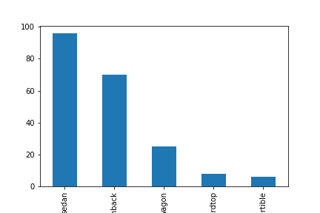
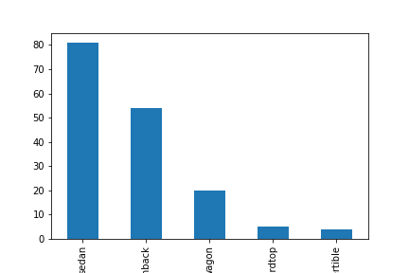
Training and Test
Original Data
Training Data

Slide 12
If we have lots of data...

Slide 13
Training, Test, and Validation Datasets
...we can partition the data into a Training, Test, and Validation dataset.
Remember…
We want to make sure we are not over fitting our data. So we have the Training and Test split..
… but we divide the data further to have one more opportunity to catch an over fit.
This second split creates a Validation dataset we can use to evaluate our final model when adjusting parameters.

Slide 14
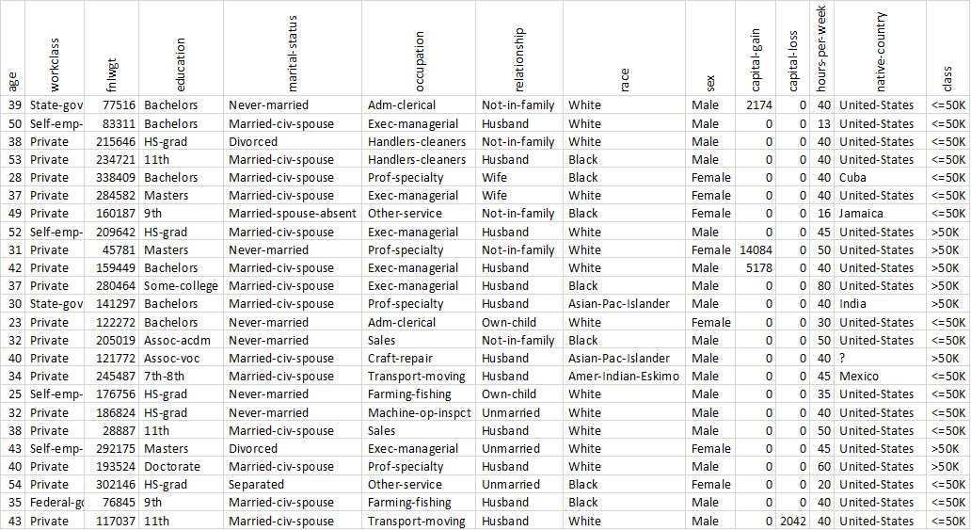
Training, Test, and Validation
Training Set
Randomly
Selected
Partitioning
Testing Set
Validation Set
32561 examples
https://archive.ics.uci.edu/ml/datasets/Adult

Slide 15
Training, Test, and Validation
import pandas as pd
import matplotlib.pyplot as plt
from sklearn.model_selection import train_test_split
data = pd.read_csv("..\\src-data\\adult.data.csv")
X = data.drop(columns=['class'])
Y = data[['class']]
X_train, X_test, Y_train, Y_test = train_test_split(X, Y, train_size = 0.80)
X = X_train
Y = Y_train
X_train, X_valid, Y_train, Y_valid = train_test_split(X, Y, train_size = 0.80)

Slide 16
Training, Test, and Validation
import pandas as pd
import matplotlib.pyplot as plt
from sklearn.model_selection import train_test_split
data = pd.read_csv("..\\src-data\\adult.data.csv")
X = data.drop(columns=['class'])
Y = data[['class']]
X_train, X_test, Y_train, Y_test = train_test_split(X, Y, train_size = 0.80)
X = X_train
Y = Y_train
X_train, X_valid, Y_train, Y_valid = train_test_split(X, Y, train_size = 0.80)
We have a 80/20 split.
80% in the training dataset
20% in the test dataset

Slide 17
Training, Test, and Validation
import pandas as pd
import matplotlib.pyplot as plt
from sklearn.model_selection import train_test_split
data = pd.read_csv("..\\src-data\\adult.data.csv")
X = data.drop(columns=['class'])
Y = data[['class']]
X_train, X_test, Y_train, Y_test = train_test_split(X, Y, train_size = 0.80)
X = X_train
Y = Y_train
X_train, X_valid, Y_train, Y_valid = train_test_split(X, Y, train_size = 0.80)
We have a training set split again into 80/20.
80% in the training dataset
20% in the validation dataset

Slide 18
Training, Test, and Validation
import pandas as pd
import matplotlib.pyplot as plt
from sklearn.model_selection import train_test_split
data = pd.read_csv("..\\src-data\\adult.data.csv")
X = data.drop(columns=['class'])
Y = data[['class']]
X_train, X_test, Y_train, Y_test = train_test_split(X, Y, train_size = 0.80)
X = X_train
Y = Y_train
X_train, X_valid, Y_train, Y_valid = train_test_split(X, Y, train_size = 0.80)
64% in the training dataset
16% in the validation dataset
20% in the test dataset

Slide 19
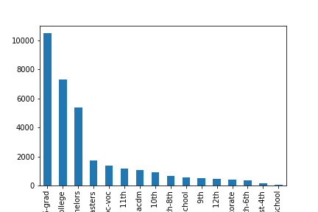
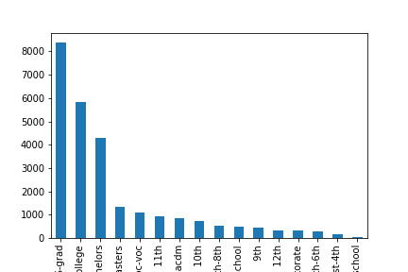
Training, Test, and Validation
Original Data
Training Data

Slide 20
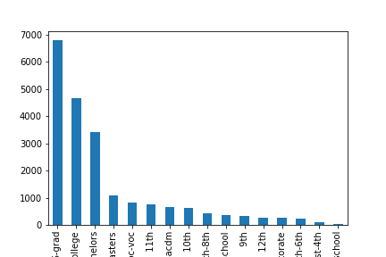
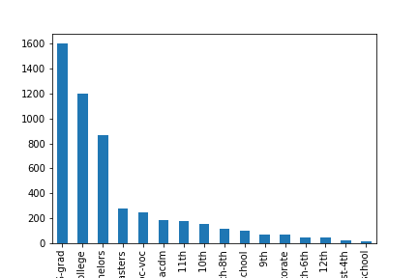
Training, Test, and Validation
Original Data
Training Data
Validation Data

Slide 21
...but what if we don’t have enough data?

Slide 22
Cross-Validation
Also called k-fold cross-validation.
We partition the data into k equally sized datasets. Commonly a k of 10 is chosen.
The data is evaluated 10 times, each time using a different dataset as the test dataset, and we get 10 error rates.
We average together the error rates and use that as the models overall error rate.

Slide 23
k-fold Cross-Validation
Randomly
Selected
Partitioning

Slide 24
k-fold Cross-Validation
Randomly
Selected
Partitioning
Notice the 10 partitions.
This is an example of k = 10

Slide 25
k-fold Cross-Validation
Train the model with k-1 of the partitions
Trained Model

Slide 26
k-fold Cross-Validation
Train the model with k-1 of the partitions
Trained Model
Test the model with the remaining partition.

Slide 27
k-fold Cross-Validation
Do it again with a different test dataset.
Train the model with k-1 of the partitions
Trained Model
Test the model with the remaining partition.

Slide 28
k-fold Cross-Validation
An again with a different test dataset, for a total of k times.
Train the model with k-1 of the partitions
Trained Model
Test the model with the remaining partition.

Slide 29
k-fold Cross-Validation
We take the k error rate values and average them together to get an overall error rate. We use this error rate to determine if the model is a good model.

Slide 30
k-fold Cross-Validation
Python
Kfold from sklearn
https://scikit-learn.org/stable/modules/generated/sklearn.model_selection.KFold.html
from sklearn.model_selection import KFold
kfold = Kfold(10,True,17)

Slide 31
Leave-one-out
A version of k-fold cross-validation where k the number of examples.
The data is evaluated k times, each time using a different example as the test dataset, and we get k error rates of either 1 or 0.
We average together the error rates and use that as the models overall error rate.

Slide 32
Leave-one-out
Train the model with k-1 of the partitions
Trained Model
Test the model with the remaining example.

Slide 33
Leave-one-out
Train the model with k-1 of the partitions
Trained Model
Test the model with the remaining example.

Slide 34
Leave-one-out
Leave-on-out does not stratify well, and does not handle balanced data.
For example:
Take the following data set [1,1,0,0]
Use Leave-one-out and
perform Knn where k = 3.
That means 4 data values, and 4 folds.

Slide 35
Leave-one-out
Does not stratify well and does not handle balanced data
 | Fold 1 | Fold 2 | Fold 3 | Fold 4
Data | 1 | 1 | 0 | 0
 | 1 | 0 | 0 | 1
 | 0 | 0 | 1 | 1
Test | 0 | 1 | 1 | 0

Slide 36
Leave-one-out
Does not stratify well and does not handle balanced data
 | Fold 1 | Fold 2 | Fold 3 | Fold 4
Data | 1 | 1 | 0 | 0
 | 1 | 0 | 0 | 1
 | 0 | 0 | 1 | 1
Test | 0 | 1 | 1 | 0
Predicted | 1 | 0 | 0 | 1
Error Rate | 0 | 0 | 0 | 0

Slide 37
Bootstrap
Bootstrap is a resampling technique, where you draw a sample of the data (with replacement). Anything not selected as part of your sample is considered part of your test group.
You will need to set a sample size (n), and a number times you sample (R). It is not unusual to resample a large number of times.
It is not unusual to resample 30 to 100 times. Some papers mention 1000 to 10000 resamples.
You will get a error value for each resample.

Slide 38
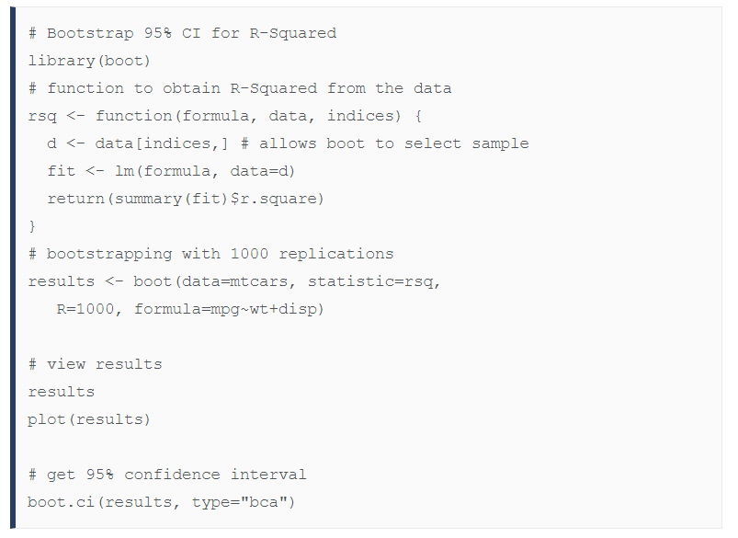
Bootstrap
https://www.statmethods.net/advstats/bootstrapping.html

Slide 39
Bootstrap
Check out this R
https://www.statmethods.net/advstats/bootstrapping.html

Slide 40
Bootstrap
Example:
We take the tragically small data set…
[1,2,3,4,5,6,7,8,9,10]
We set a sample size (n) of 6, and resample (R) 4 times, with replacement.

Slide 41
Bootstrap
Example:
We take the tragically small data set…
[1,2,3,4,5,6,7,8,9,10]
We set a sample size (n) of 6, and resample (R) 4 times, with replacement.
9
1
3
7
4
5
2
6
8

Slide 42
Bootstrap
Example:
We set a sample size (n) of 6, and resample (R) 4 times, with replacement.
9
Sample 1
[7,10,2,3,1,2]
1
3
7
5
10
4
2
6
8

Slide 43
Bootstrap
Example:
We set a sample size (n) of 6, and resample (R) 4 times, with replacement.
9
Sample 1
[7,10,2,3,1,2]
1
3
7
5
10
4
2
6
8

Slide 44
Bootstrap
Example:
We set a sample size of 6, and resample 4 times, with replacement.
Training Data
Test Data
9
Sample 1
[7,10,2,3,1,2] [4,5,6,8,9]
1
3
7
5
10
4
2
6
8

Slide 45
Bootstrap
Example:
We set a sample size of 6, and resample 4 times, with replacement.
Training Data
Test Data
9
Sample 1
[7,10,2,3,1,2] [4,5,6,8,9]
1
3
7
5
10
Sample 2
4
[6,4,8,9,7,5] [1,2,3,10]
2
6
8
Sample 3
[5,1,2,5,9,4] [3,6,7,8,10]
Sample 4
[7,4,4,8,8,8] [1,2,3,5,6,9,10]

Slide 46
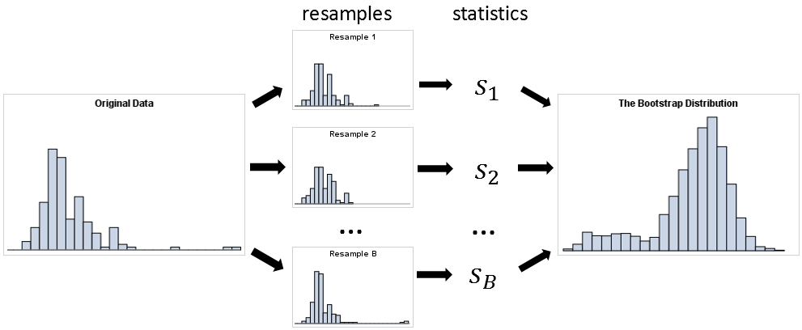
Bootstrap
https://blogs.sas.com/content/iml/2018/12/12/essential-guide-bootstrapping-sas.html

Slide 47
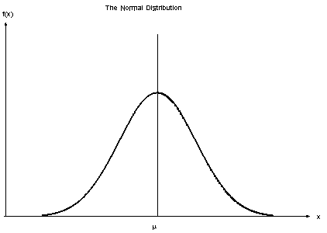
Bootstrap
Example:
We use each sample to train the test, and the test data to get an error rate for each sample. If we do this enough times, thanks to the Central Limit Theorem, we should get a normal distribution of error rates. We go with the mean of our error rate for the models error.
https://www.itl.nist.gov/div898/handbook/pmc/section5/pmc51.htm

Slide 48
What we covered.
Training and Test Sets
Cross-Validation
Leave-one-out
Bootstrap

Slide 49
References
Efron, B., & Tibshirani, R. J. (1994). An introduction to the bootstrap. CRC press.
Shmueli, G., Bruce, P. C., Yahav, I., Patel, N. R., & Lichtendahl Jr, K. C. (2017). Data mining for business analytics: concepts, techniques, and applications in R. John Wiley & Sons.
Witten, I. H., Frank, E., Hall, M. A., & Pal, C. J. (2016). Data Mining: Practical Machine Learning Tools and Techniques.

